Slide 1
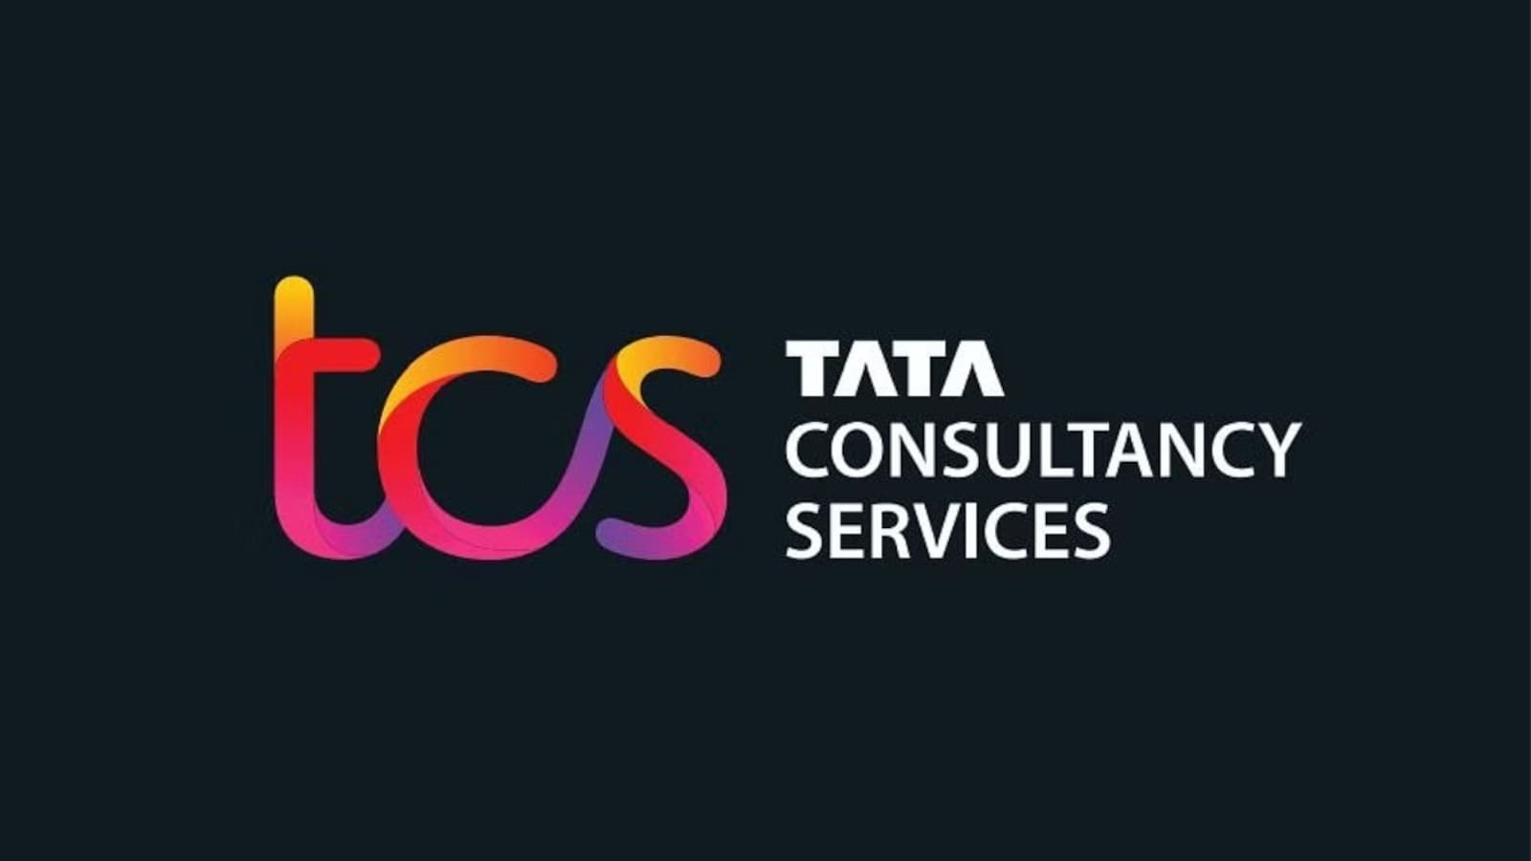

Slide 2
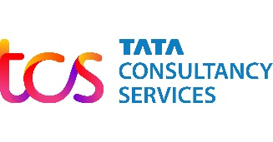
INTRODUCTION
Who we are- Building greater futures through innovation and collective knowledge
Tata Consultancy Services is an IT services, consulting and business solutions organization that has been partnering with many of the world’s largest businesses for the past 50 years.
Industry | Information technology Consulting Outsourcing
Founded | 1968; 55 years ago
Founder | J. R. D. Tata
Headquarters | Mumbai, Maharashtra, India
A part of the Tata group, India's largest multinational business group, TCS has over 500,000 of the world’s best-trained consultants in 46 countries. The company generated consolidated revenues of US $22.2 billion in the fiscal year ended March 31, 2021, and is listed on the BSE and the NSE in India.
Employees-615K workforce globally distributed
Diversity- 35.8 % women in workforce with 84%+ increase in executive roles over 5years

Slide 3
Belief Powers Business
At TCS, we go beyond helping businesses transform through technology. We help them make a meaningful difference; to their customers, and to the communities they serve.
Our Belief- We believe pioneers and innovators are at home in the unknown
Board Members- N. Chandrasekaran, Mr. OP Bhatt, Aarthi Subramaniam
Executive Leadership Team- K.Krithivasan, Milind Lakkad, Samir Sekaria
Investors- Positioned for Long Term Sustainable Growth
OUR LEADERSHIP TEAM
Q2 FY 2023-24
Revenue at $7.210 billion, +4.8% YoY | Net Income at $1.37 billion, +5.6% YoY | Net Margin at 19%

Slide 4

INDUSTRY BACKGROUND
WHAT IT INDUSTRY DO: -
IT workers can specialize in fields such as software development, application management; hardware components; server, storage or network administration.
The Information Technology Industry is one of the leading sectors in India, sharing 9.3% of the country's GDP, making it one of the biggest sectors contributing to India’s economic growth.

Slide 5
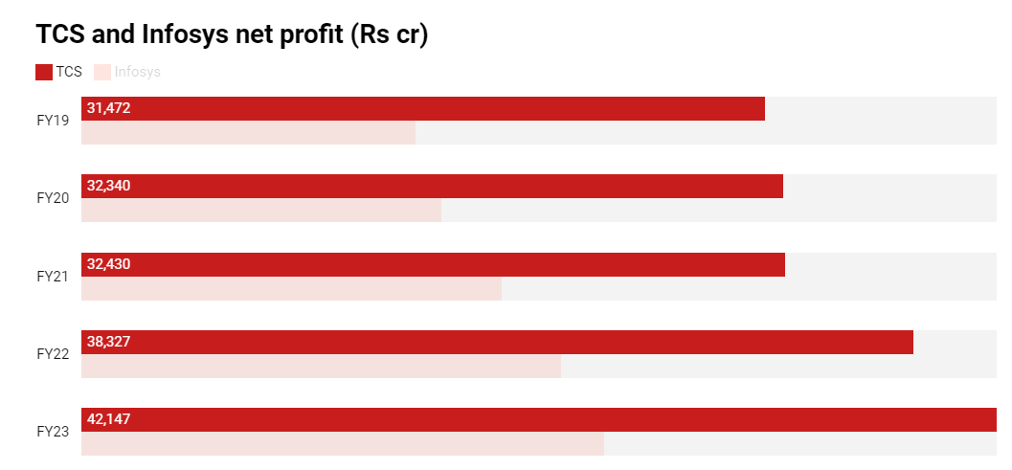
TCS is known for the variety of services that it provides its clients , including
the latest and advanced technologies. The services include Analytics and Insights, Blockchain, Cognitive Business Operations, Cyber Security, Enterprise Applications, Quality Engineering, Automation, AI, Cloud, etc.
TCS vs Infosys: Profitability

Slide 6

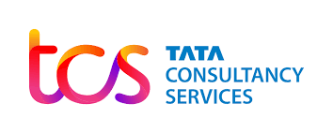
PROFITABILITY RATIO OF Tata Consultancy Services

Slide 7
Profitability ratios are financial metrics used to measure how well a company generates profit and value for shareholders.
GROSS PROFIT= Gross Profit/ Sales*100
NET PROFIT= Net Profit/ Sales*100
CALCULATIONS:
Gross Profit:
REVENUE – COST OF GOOD SOLD
Net Profit:
Net Profit = NET PROFIT/SALES*100
OR-
EARNINGS AFTER TAX/SALES*100
TATA CONSULTANCY SERVICES
PROFITABILITY RATIO
INR (CRORES) | 2021 | 2022 | 2023
GROSS PROFIT
Revenue from Operation | 1,64,177 | 1,91,754 | 2,25,458
Cost of Good Sold[Cost of equipment & Software Licenses] | 1,462 | 1,163 | 1,881
TOTAL | 1,62,715 | 1,90,591 | 2,23,577
Gross Profit Margin | 99.11 | 99.39 | 99.17
NET PROFIT
Total Income [revenue from operation + other income] | 1,67,311 | 1,95,772 | 2,28,907
Total Expenses | 1,22,333 | 1,44,085 | 1,72,000
TOTAL | 44,978 | 51,687 | 56,907
less: Provision Towards Legal Claim | 1,218 | NIL | NIL
Profit Before Tax | 43,760 | 51,687 | 56,907
Total Tax Expense | 11,198 | 13,238 | 14,604
Profit After Tax | 32,562 | 38,449 | 42,303
Net Profit Margin | 19.46 | 19.64 | 18.48

Slide 8
Liquidity ratios :
Year 2021 :
Current assets = 83160
Current liabilities = 28525
Inventories = 7
Current ratio = current assets
= 83160 = 2.91
Current liabilities
28525

Slide 9
Year 2022 :
Current assets : 94192
Current liabilities : 37901
Inventories :19
Current ratio = current assets
= 94192
37901
= 2.48
Current liabilities

Slide 10
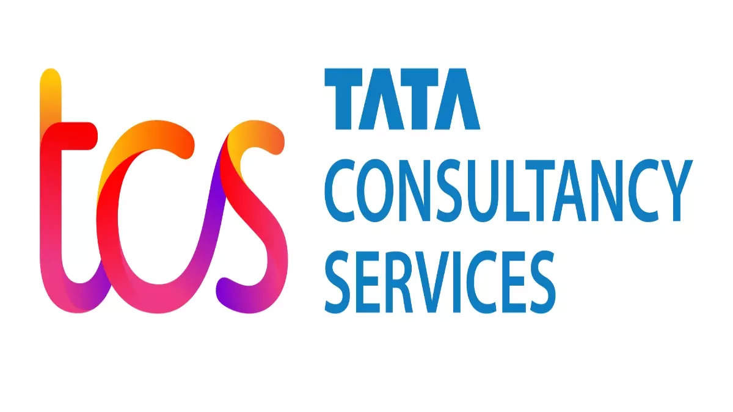
Solvency Ratio
The solvency ratio indicates whether the cash flow of the company will be sufficient to cover its short-term and long-term liabilities.
Lower the value of solvency ratio indicates a greater probability of default on its debt obligations
Higher the value of the solvency ratio better the liquidity position of the company

Slide 11
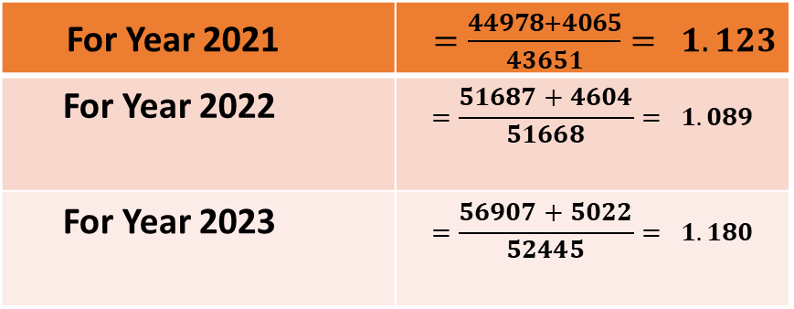

Solvency ratio$=\frac{(Net Income+Depriciation)}{All Liabilities}$
For Year 2021 | $=\frac{44978+4065}{43651}= 1.123$
For Year 2022 | $$=\frac{51687+4604}{51668}= 1.089$$
For Year 2023 | $$=\frac{56907+5022}{52445}= 1.180$$
Note : Net Income = Total Revenues – Total Expenses All Liabilities = Short-term + Long-term liabilities
Solvency Ratio
Debt to equity ratio
Proprietary Ratio

Slide 12

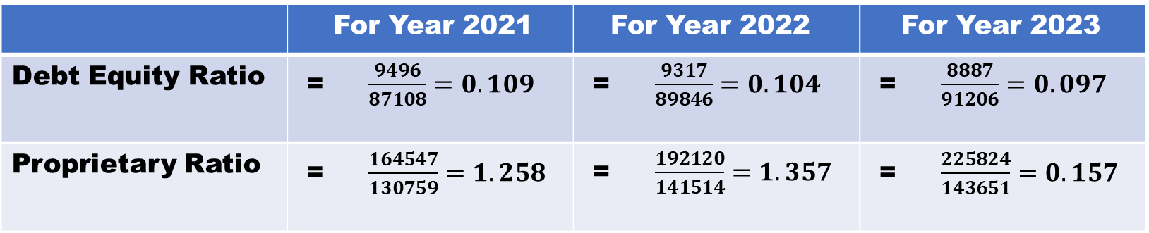
CALCULATIONS
Debt to equity Ratio $= \frac{Total Debt}{Total Equity}$
Proprietary Ratio = $\frac{Shareholder Funds}{Total Assets}$
 | For Year 2021 | For Year 2022 | For Year 2023
Debt Equity Ratio | = $\frac{9496}{87108}=0.109$ | = $\frac{9317}{89846}=0.104$ | = $\frac{8887}{91206}=0.097$
Proprietary Ratio | = $\frac{164547}{130759}=1.258$ | = $\frac{192120}{141514}=1.357$ | = $\frac{225824}{143651}=0.157$
Shareholder fund = Revenue + Capital

Slide 13
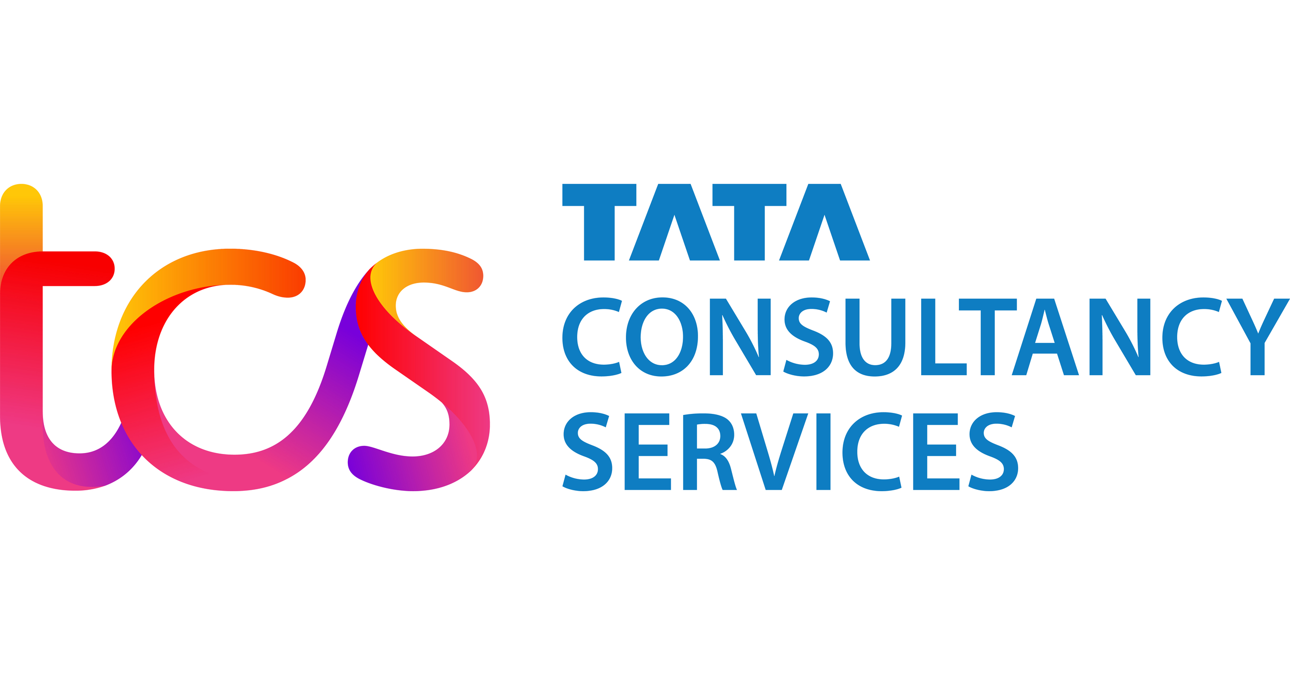

MARKET CAPITALISATION

Slide 14
Information | Details
Share Price (NSE) | ₹3455.651
Share Price (BSE) | ₹3507.052
Market Cap | ₹12,76,003 Crores
Outstanding Shares | 3,659,616,6563
Dividend Yield | 1.45%1
P/E Ratio | 28.321

Slide 15
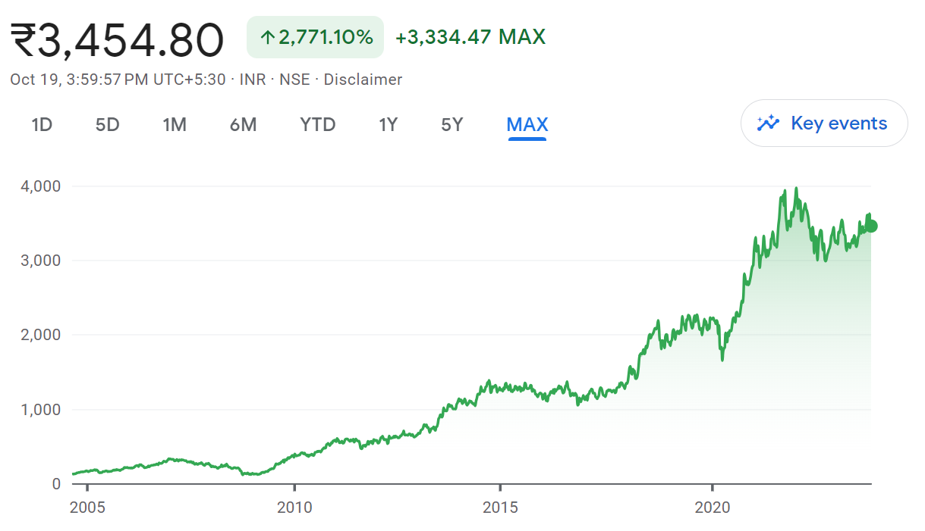
Share Price from Inception

Slide 16
Financial Information
  TCS is a multinational information technology service company headquartered in Mumbai, India.
  It provides IT, business consulting, and outsourcing services in over 46 countries.
  As of March 31, 2023, TCS had almost 616,000 employees worldwide.
  The company’s free cash flow yield for fiscal years ending March 2019 to 2023 averaged 3.3%.
  TCS’s latest twelve months free cash flow yield is 3.3%.
  The company’s operating income in FY 2023 amounted to about 535 billion Indian rupees, up from about 476 billion Indian rupees in fiscal year 20224.
  TCS’s total assets as of 2023 were ₹143,651 crore (US$18 billion).
  The total equity of TCS in 2023 was ₹91,206 crore (US$11 billion)

Slide 17
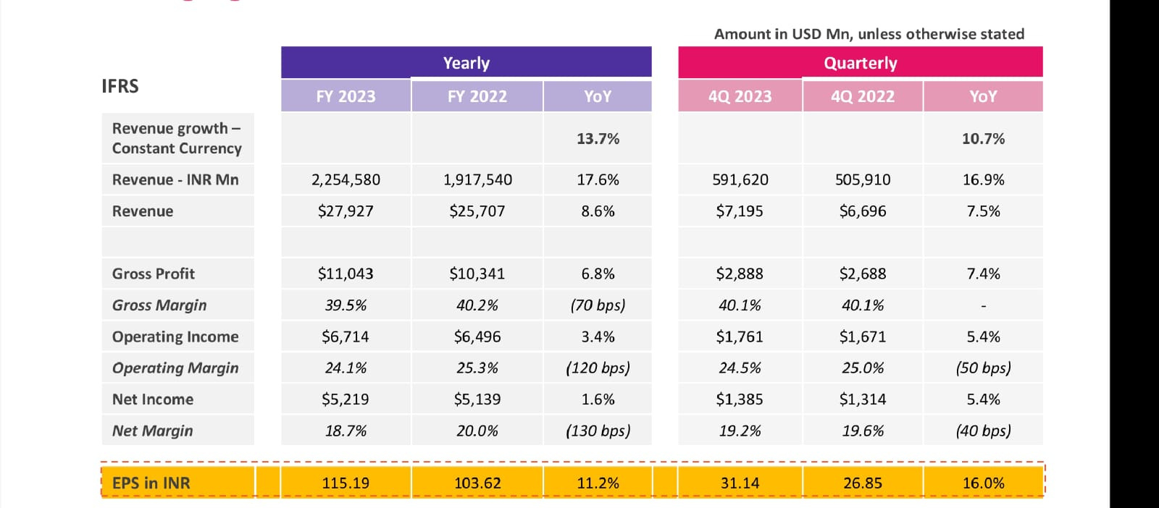
Financials

Slide 18
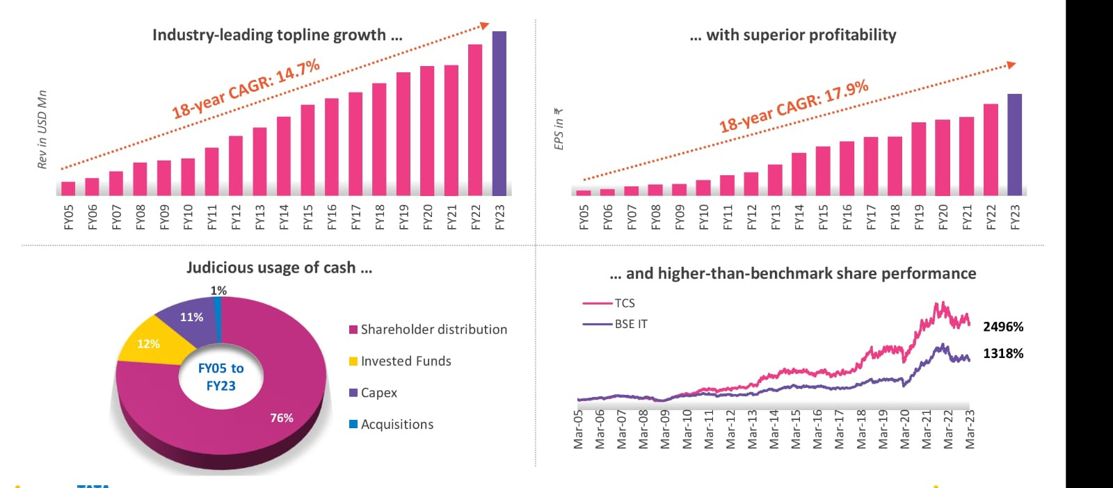
Financials

Slide 19
LATEST NEWS
TCS reported a decline in workforce . Net decrease of 6,333 employees
in latest quarter .
TCS is in cost cutting mode
TCS fires 16 employees connected with “ RECRUITMENT SCAM “.
TCS net sales is Rs 50,165 crores up to 7.15%.

Slide 20
TCS trains over 1,00,000 employees to build generative AI ready workforce .
TCS expands partnership with africa’s standard bank group to centralise security settlements .
TCS can return up to 14% in short term .
TCS takes month evaluation approach as customer reprioritize projects , defer spends

Slide 21
CORPORATE GOVERNANCE REPORT

Slide 22
Employee Access to the Board
Employees at TCS are highly empowered; the company's culture encourages open communication and puts up several channels for communicating concerns.
Sustainability and Risk Management
TCS Risk Office maintains a Risk Register and draws up suitable risk mitigation plans for each of the risks identified therein. These risks are reviewed by the Board periodically.
Protecting Minority Shareholders' Interests
The corporate governance philosophy at TCS based on the Tata Code of Conduct, fairness and transparency to all stakeholders. The company also has a variety of channels through which minority shareholders can interact with the management/ board to express their concerns.

Slide 23
Remuneration Policy
Remuneration of the Managing Director and Executive Directors consists of a fixed component (salary, benefits, and allowances) and a performance-liked variable component (commission).The Remuneration Committee decides the annual increments within the salary scale approved by the Members and within the ceilings prescribed under by law.
Independent and Effective Validation
TCS has an independent third party. To oversee and carry out internal audits of the company's operations as per an internal audit plan which is reviewed annually by the Audit Committee in consultation with the Auditors.
Fiscal Oversight
An Audit Committee, consisting entirely of independent, non-executive Directors, oversees TCS disclosure process to ensure that sufficient and credible information is disclosed.

Slide 24
THANK YOU

